Slide 1

Unveiling the Drivers behind Default
Data Science Group 4

Slide 2
“Bad loans arise when the
borrower no longer pays in
accordance with the terms of the loan. “
Fredriksson & Frykström (2019)

Slide 3
AGENDA
Introduction
The Team
Idea
Problems
Learnings
Results

Slide 4
INTRODUCTION
Lending Club
Importance of Data
Project Context
Background: San Francisco-based pioneer in peer-to-peer lending; first to offer SEC-registered loans and a secondary loan trading market.
Achievements: Largest global peer-to-peer lending platform, transforming personal and business loans
Data-Driven Strategies: Extensive data analysis drives loan approval, mitigating risk and boosting profitability.
Business Impact: Accurate decisions prevent missed opportunities and reduce credit losses.
Objective: Enhance loan approval by predicting default risks using EDA and Machine Learning.
Expected Outcome: Improved predictions reduce financial losses and refine lending strategies.

Slide 5





MEET THE TEAM
Hammam
Jieun
Arsen
Mohamad
Fiona
Mentor: Nopparat Wasikanon

Slide 6
PROJECT OUTLINE
Data Overview
Technological Framework
Initial Steps
Data
Tools
Adjustments
Dataset: Historical LendingClub loan data, including outcomes like Fully Paid, Charged-off, Current.
Features: Loan amount, interest rate, employment details, income, debt-to-income ratio, etc.
Libraries: Python with Pandas, NumPy, Scikit-Learn for analysis; Matplotlib, Seaborn for visualization.
Machine Learning: Compared Random Forest and ANN models to predict defaults.
Data Prep: Cleaned data, handled missing values, normalized, and encoded variables.
Preliminary EDA: Analyzed key variables and their link to loan defaults.

Slide 7
OUR GOAL
Develop predictive models to identify potential loan defaulters, minimizing credit loss.

Slide 8
CHALLENGES & SOLUTIONS
Data Complexity and Volume
Implemented efficient data processing techniques using Pandas and NumPy.
Missing Data and Outliers
Applied multiple imputation techniques and robust scaling methods to manage outliers.
Model Selection and Tuning
Used ensemble methods like Random Forest to improve performance and reliability.

Slide 9
LEARNINGS
Technical Learnings
Personal Learnings
Reflection on the Project
Thoughts of Improvement
Overall Impression
Data Handling: Mastered large dataset management with Pandas and NumPy.
Modeling: Improved skills in Random Forest and ANNs;.
Problem-Solving: Strengthened analytical skills for data integrity and model selection.
Collaboration: Good communication within the team is essential
Challenges: Underestimated time for data cleaning and data understanding
Positives: Collaboration and mentor support were key to success.
Improvements: More focus on EDA to identify key variables earlier.
Early Planning: Prioritize preliminary data analysis for better modeling
Group Management: Earlier agreements on joint meetings
Coordination: More clearity about responsibilities
Impact: Realizing the importance of data analysis in the real world
Personal Takeaway: Successful project work needs good communication

Slide 10
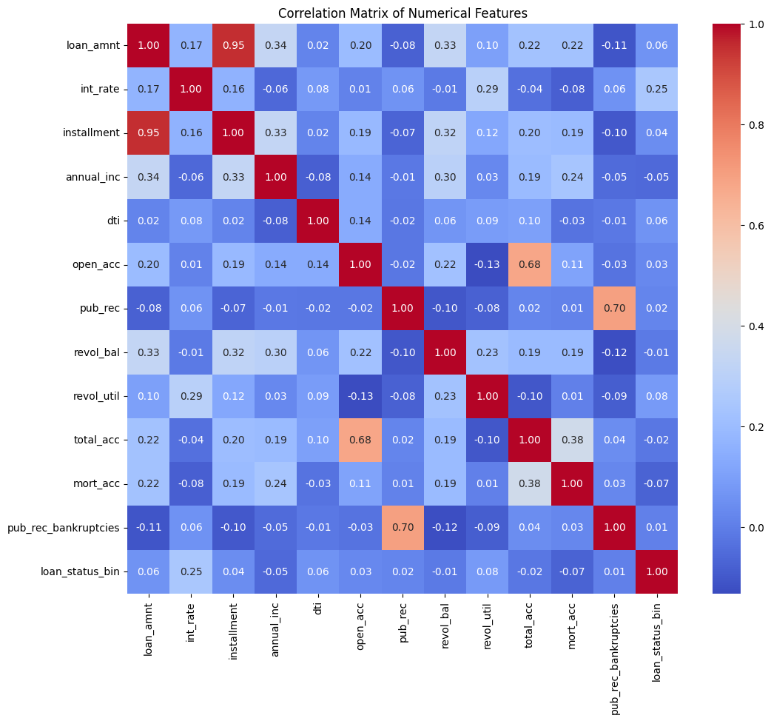
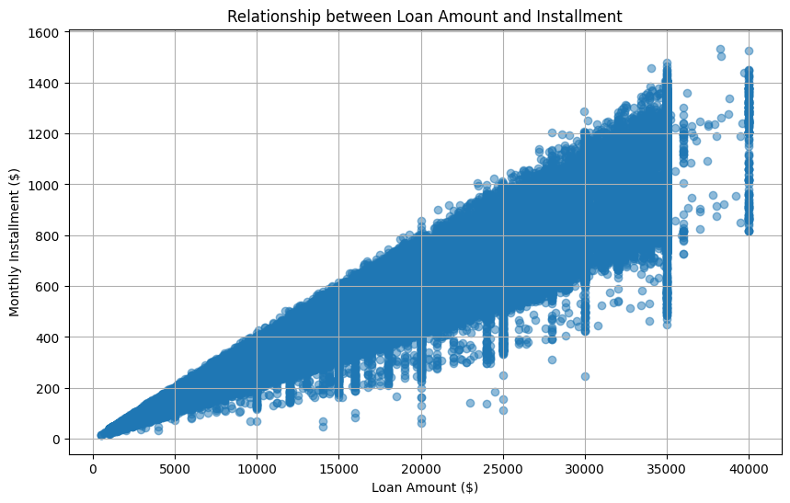
RESULTS (EDA)
We noticed almost perfect correlation between "loan_amnt" the "installment" feature (0.95).
Clear linear pattern indicating a strong linear relationship, confirming the hypothesis about their correlation.

Slide 11
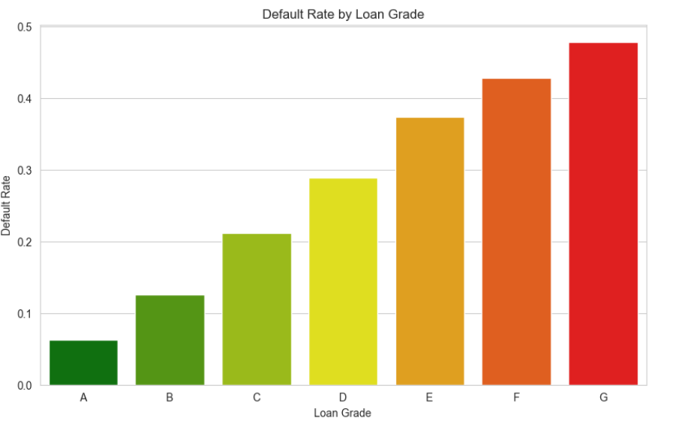
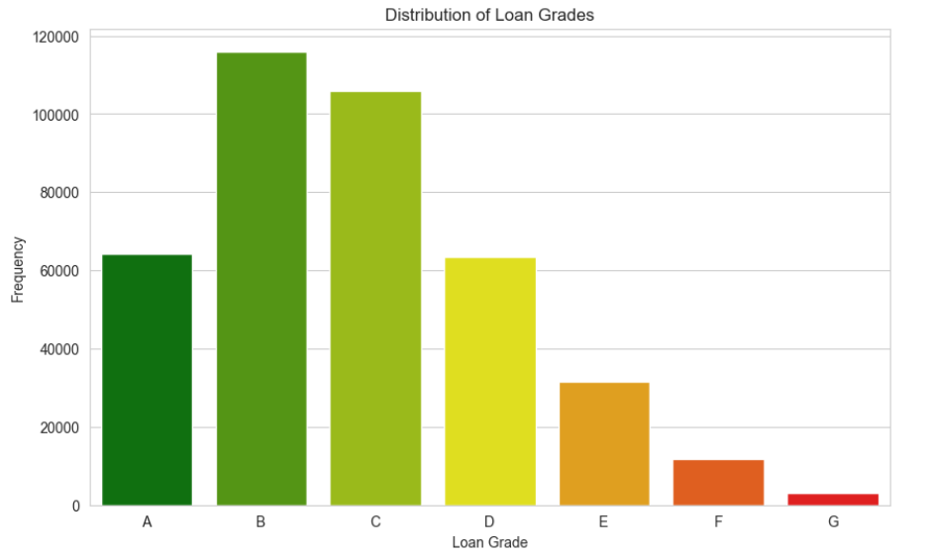
RESULTS

Slide 12
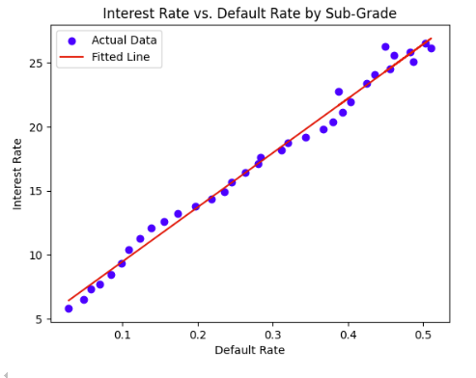
LINEAR REGRESSION I
Interest Rate vs. Default Rate
Risk Compensation
The large slope indicates that the interest rate is highly responsive to changes in perceived risk, which is consistent with how financial institutions manage their exposure to potential losses.
Lenders often charge higher rates to riskier borrowers to compensate for the greater risk of loan default.
interest rate = 5.216621308807113 + 42.43980704484836 * default rate
The positive coefficient for the default rate suggests a direct relationship between risk (default rate) and the price of borrowing (interest rate).
For every 1% increase in the default rate, the interest rate increases by about 42.43 percentage points. This indicates a strong sensitivity of interest rates to changes in the default rate

Slide 13
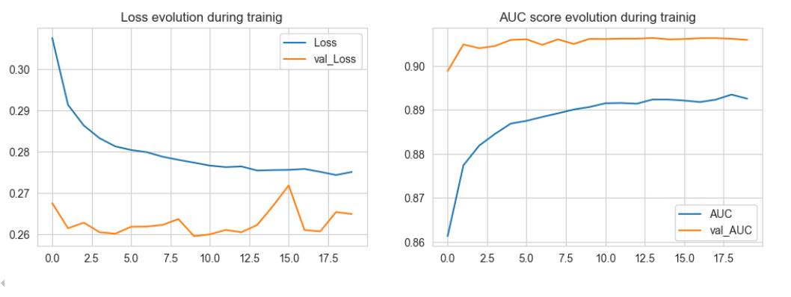
RESULTS (ANNS)
Train Result: ================================================ Accuracy Score: 88.87%
Test Result: ================================================ Accuracy Score: 88.82%

Slide 14
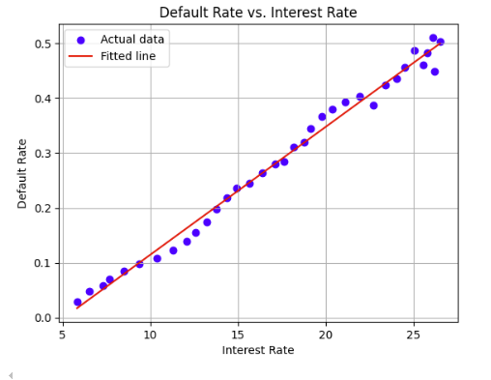
LINEAR REGRESSION II
Default Rate vs. Interest Rate
Financial Burden
The positive relationship is logical and aligns with financial principles, higher interest rates often correlate with higher default risks as they can increase the financial burden on borrowers, potentially leading them to default.
For each 1% increase in the interest rate, the default rate increases by 0.0233, or 2.33 percentage points.
Default rate = -0.1186 + 0.0233 * interest rate

Slide 15
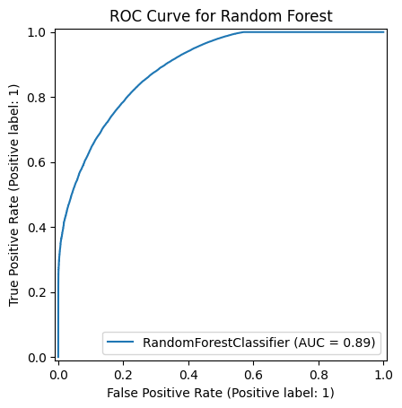
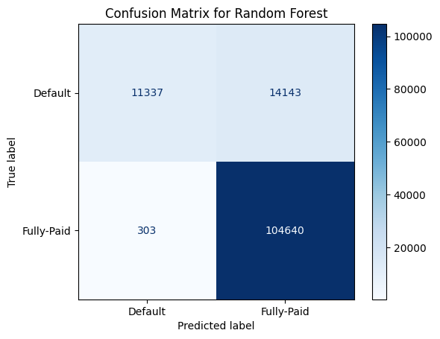
RESULTS (Random Forest)
Train Result: ================================================ Accuracy Score: 94.36%
Test Result: ================================================ Accuracy Score: 88.92%

Slide 16
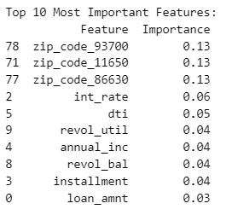
RESULTS

Slide 17
Thank you!

Slide 18
APPENDIX

Slide 19
